Slide 1


High Performance Browser Networking
what every web developer should know about networking and browser performance
Ilya Grigorik - @igrigorik
igrigorik@google.com

Slide 2

Our agenda for the day...
Connection speed
Latency and bandwidth
Bandwidth doesn’t matter (much)
Transports: TCP, TLS
Connection setup + congestion control
Protocol optimizations
Wireless networking
Implications of shared channel
Impact of battery life
Performance best practices
Optimizing application delivery
The good and the bad of HTTP 1.x
Brief introducing to HTTP 2.0
@igrigorik

Slide 3
Web performance this, …, that ...
Networks will just get faster and all of our problems will go away. Right?
… sadly, nope.

Slide 4
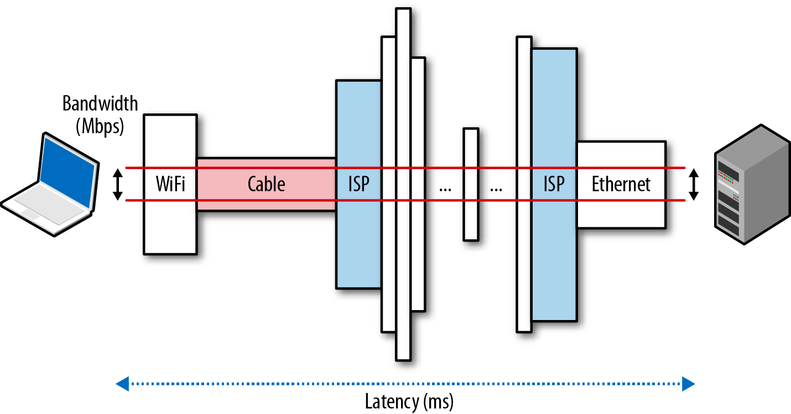
ISPs and carriers love to advertise bandwidth as “speed”.
ISP sells the “last mile” connection; ISP can’t guarantee end-to-end throughput.
When was the last time you saw an ISP advertise latency? Right, never...
Speed is a feature (Chapter 1)
@igrigorik

Slide 5
Speed of light is not fast enough!
Route | Distance | Time light in vacuum | Time light in fiber | Round-trip time (RTT) in fiber
New York to San Francisco | 4,148 km | 14 ms | 21 ms | 42 ms
New York to London | 5,585 km | 19 ms | 28 ms | 56 ms
New York to Sydney | 15,993 km | 53 ms | 80 ms | 160 ms
Equatorial circumference | 40,075 km | 133.7 ms | 200 ms | 200 ms
42 ms RTT for a single packet between NYC and San Francisco
56 ms RTT for a single packet between NYC and London
Oh, and these are great-circle distances. The actual RTT’s are even higher!
And then there is the “last-mile latency” problem...
Speed is a feature (Chapter 1)
@igrigorik

Slide 6
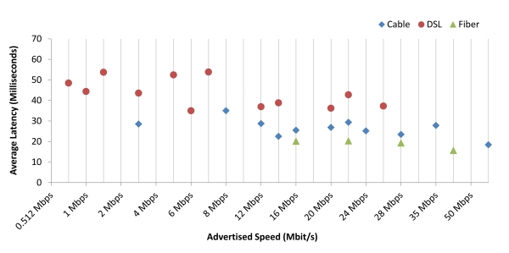
Last mile is slow!
Fiber-to-the-home services provided 18 ms round-trip latency on average, while cable-based services averaged 26 ms, and DSL-based services averaged 43 ms. This compares to 2011 figures of 17 ms for fiber, 28 ms for cable and 44 ms for DSL.
Measuring Broadband America - July 2012 - FCC
@igrigorik

Slide 7
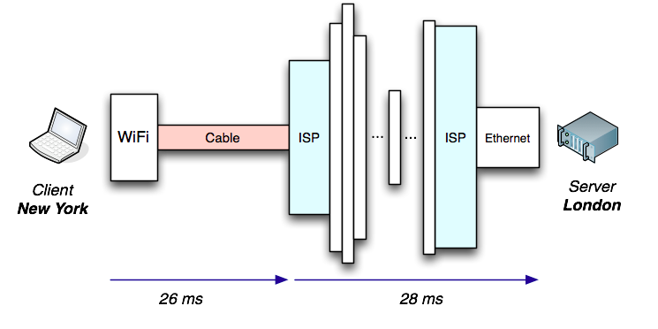
Last mile == Transatlantic hop? Wat!? Yeah...
(26 + 28) * 2
108 ms RTT!
Now you know why carriers don’t advertise these numbers…
If you look hard enough, you can find them in their FAQ’s.
Tip… $> traceroute destination.com
Speed is a feature (Chapter 1)
@igrigorik

Slide 8
Worldwide: ~100 ms
US: ~50~60 ms
Average RTT to Google in 2012 was…
and sadly it’s not improving much

Slide 9

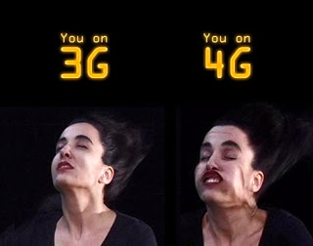

4G will save us all! Says marketing guy...
"Users of the Sprint 4G network can expect to experience average speeds of 3 Mbps to 6 Mbps download and up to 1.5 Mbps upload with an average latency of 150 ms. On the Sprint 3G network, users can expect to experience average speeds of 600 Kbps - 1.4 Mbps download and 350 Kbps - 500 Kbps upload with an average latency of 400 ms."
Mobile Networks (Chapter 7)
@igrigorik

Slide 10

(everytime I see a “4G speed” advertisement)

Slide 11
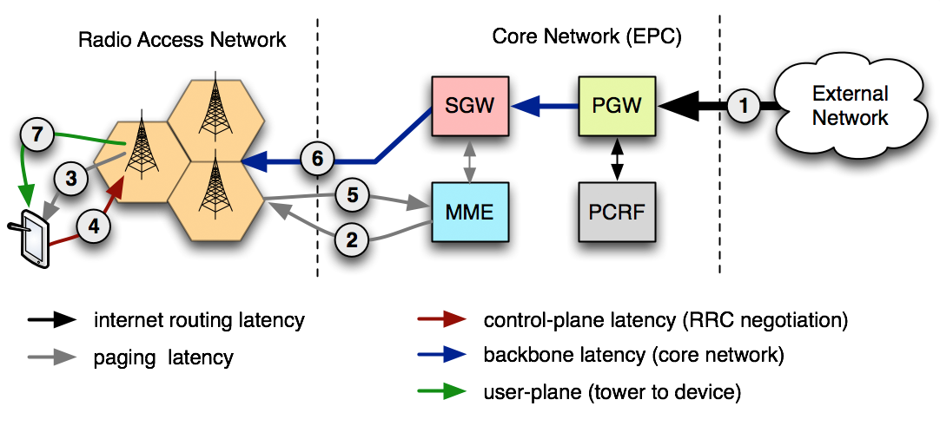
Wireless “last mile” is, painful...
 | LTE | HSPA+ | HSPA | EDGE | GPRS
AT&T core network latency | 40-50 ms | 50-200 ms | 150-400 ms | 600-750 ms | 600-750 ms
Mobile Networks (Chapter 7)
@igrigorik

Slide 12
OK. Latency is a problem.
but bandwidth is important too, how we’re doing there?

Slide 13
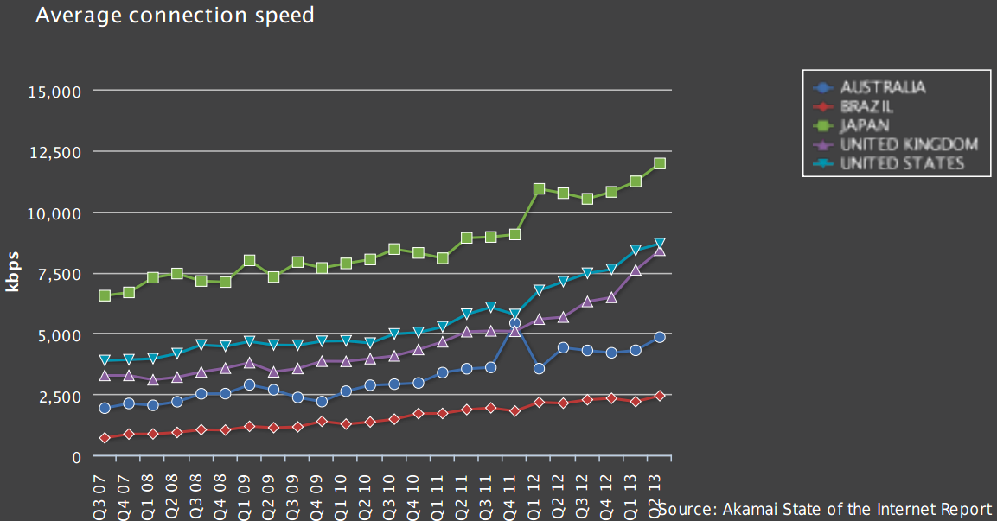
Brazil: ~2.5Mbps, Australia: ~5Mbps, US, UK: ~8Mbps
State of the Internet - Akamai - 2007-2013

Slide 14
Good news, mobile BW is improving rapidly!
Generation | Data rate
2G | 100 – 400 Kbit/s
3G | 0.5 – 5 Mbit/s
4G | 1 – 50 Mbit/s
That’s what the ads are all about. Yes, last-mile latency is also much better (~50 ms), but that’s still worse than most wired connections!
Mobile Networks (Chapter 7)
@igrigorik

Slide 15
Bandwidth + Latency ≈ Performance
but what’s the actual relationship between these factors?

Slide 16
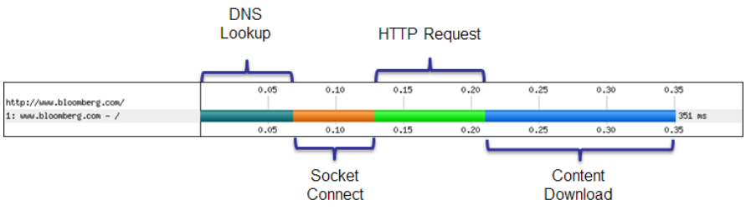
Components of an HTTP request
DNS lookup to resolve the hostname to IP address
New TCP connection requires a handshake roundtrip to the server
TLS handshake (not shown) with up to two extra server roundtrips
HTTP request requires minimum of a one roundtrip to the server
Plus server processing time
Primer on Web Performance (Chapter 10)
@igrigorik

Slide 17
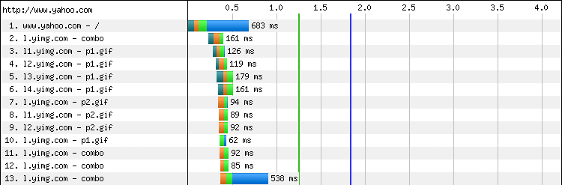
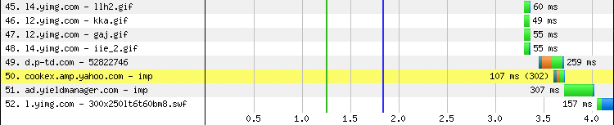
Our pages consist of dozens of assets
… (snip 30 requests) ...
52 requests
4+ seconds
Huh?
Primer on Web Performance (Chapter 10)
@igrigorik

Slide 18
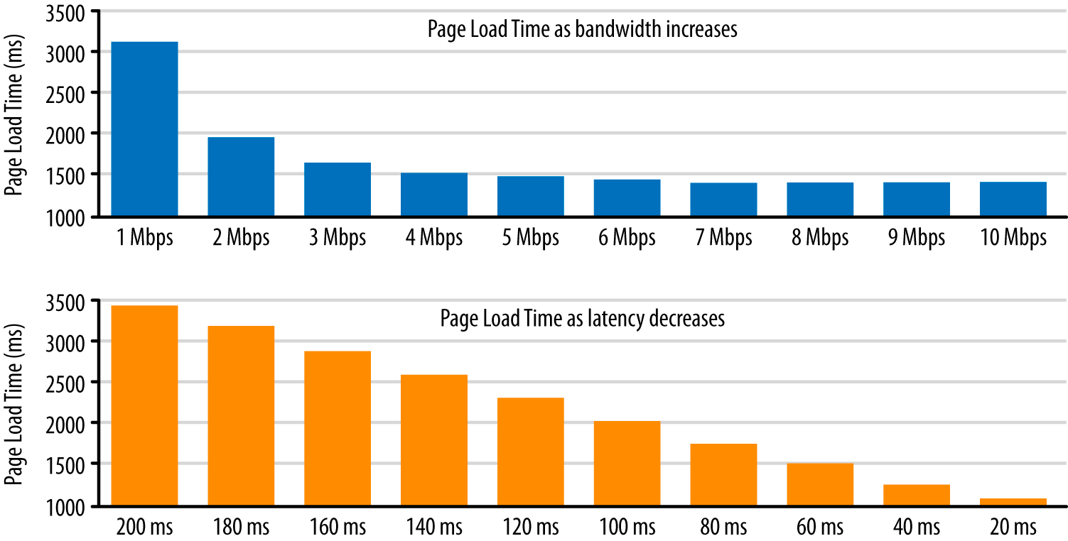
Latency vs. Bandwidth impact on Page Load Time
Single digit % perf improvement after 5 Mbps
Linear improvement in page load time!
“To speed up the Internet at large, we should look for more ways to bring down RTT. What if we could reduce cross-atlantic RTTs from 150 ms to 100 ms? This would have a larger effect on the speed of the internet than increasing a user’s bandwidth from 3.9 Mbps to 10 Mbps or even 1 Gbps.” - Mike Belshe
Primer on Web Performance (Chapter 10)
@igrigorik

Slide 19

Video streaming is bandwidth limited.
Web browsing is latency limited.
Why? To answer that, let’s dig a bit deeper...

Slide 20
Optimizing transport performance
aka, optimizing TCP and TLS...

Slide 21
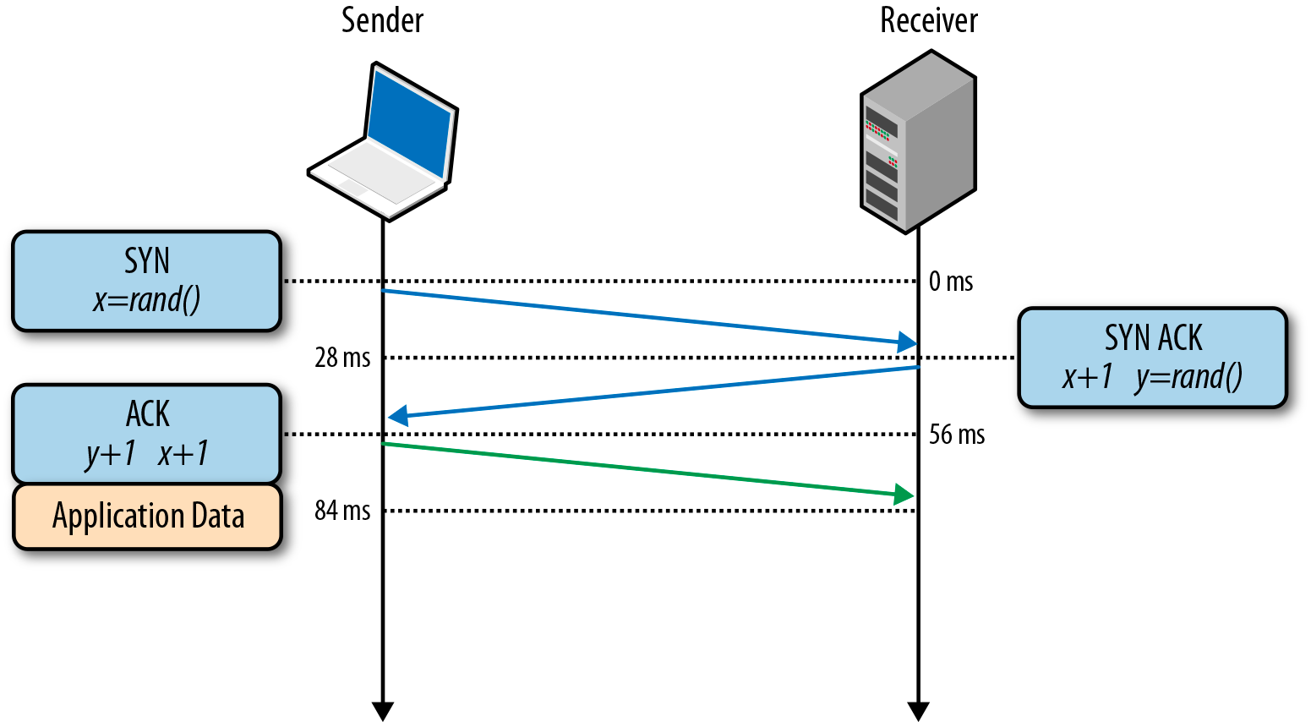
SYN, SYN-ACK, ACK
Every TCP connection begins with a handshake (SYN > SYN-ACK > ACK)
No data can be sent until the handshake is complete (one RTT)
e.g. 56 ms in example above
Building blocks of TCP (Chapter 2)
@igrigorik

Slide 22
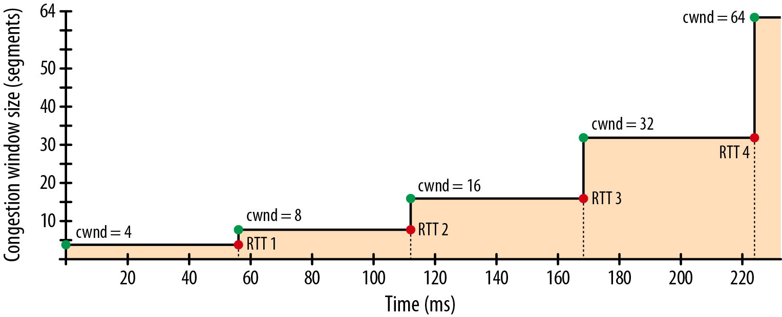
TCP Slow-Start (congestion control)
Server is only allowed to send 4 segments (cwnd = 4)
Once segments are acked, we double the window to 8 packets. Rinse, repeat...
Building blocks of TCP (Chapter 2)
@igrigorik

Slide 23
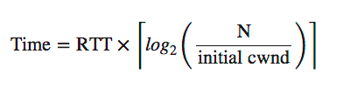
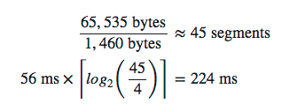
Let’s do science to it…
RTT: roundtrip time between client and server
cwnd: initial congestion window size
N: number of segments we want to transfer
segment: ~1460 bytes.
How long would it take to transfer 64 KB?
(on a new TCP connection)
Answer: 224 milliseconds + handshake RTT = 280 ms
Ouch.
Building blocks of TCP (Chapter 2)
@igrigorik

Slide 24
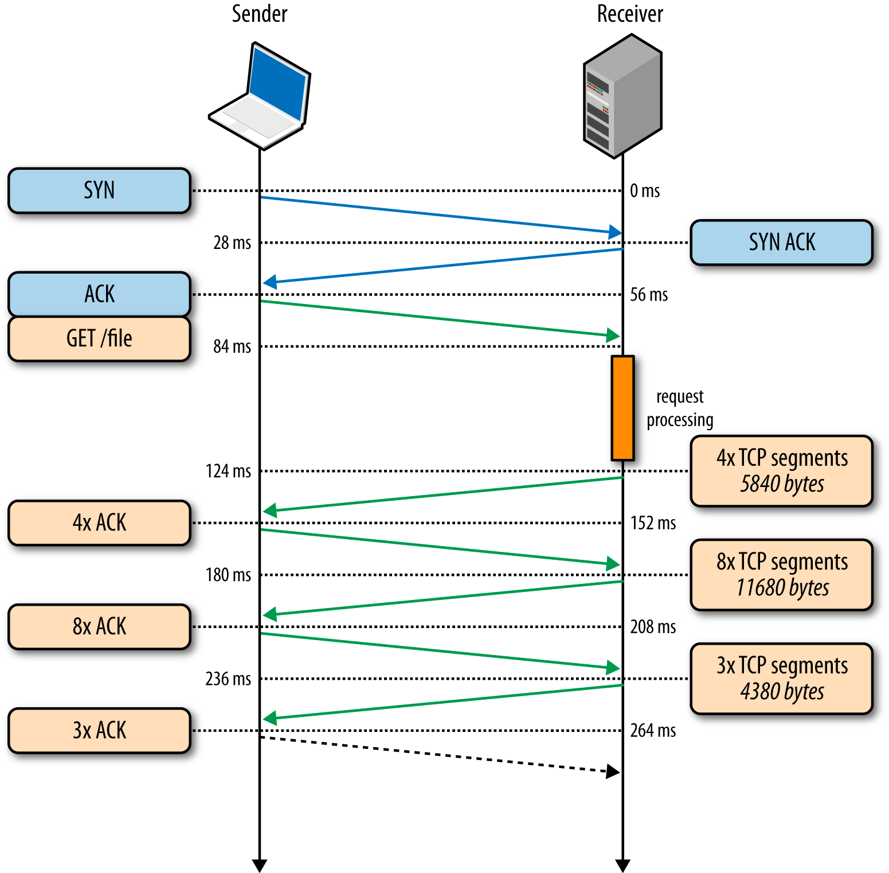
Let’s fetch a 20 KB HTML file...
RTT: 56 ms
Bandwidth: 5 Mbps
cwnd: 4
56 ms for TCP handshake
40 ms for request processing
4x segments
8x segments
3x segments
236 milliseconds!
Building blocks of TCP (Chapter 2)
@igrigorik

Slide 25
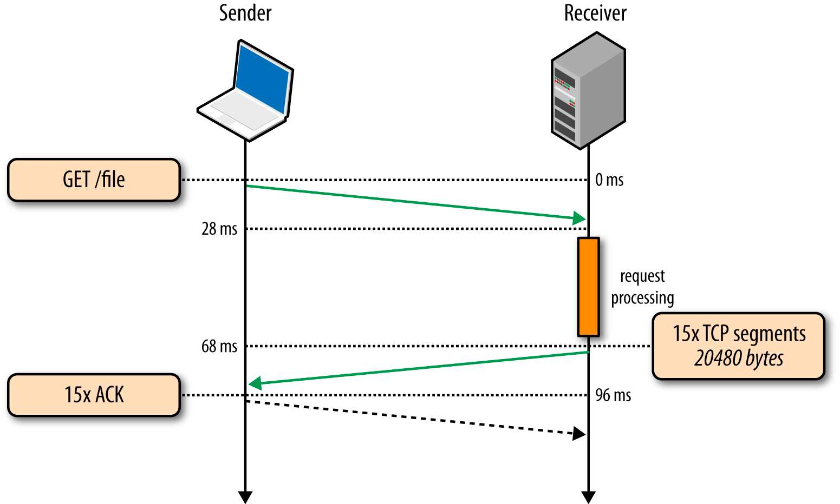
Let’s fetch same file over existing TCP connection.
RTT: 56 ms
Bandwidth: 5 Mbps
cwnd: 11
no TCP handshake...
40 ms for request processing
11 segments
96 milliseconds - 275% improvement!
Re-use existing TCP connections!
Also, notice that we’re (still) nowhere close to our 5 Mbps “bandwidth ceiling”.
Building blocks of TCP (Chapter 2)
@igrigorik

Slide 26
Most of the HTTP data flows consist of small, bursty data transfers, whereas TCP is optimized for long-lived connections and bulk data transfers. Network roundtrip time is the limiting factor in TCP throughput and performance in most cases. Consequently, latency is the performance bottleneck for HTTP and most web applications delivered over it.

Slide 27
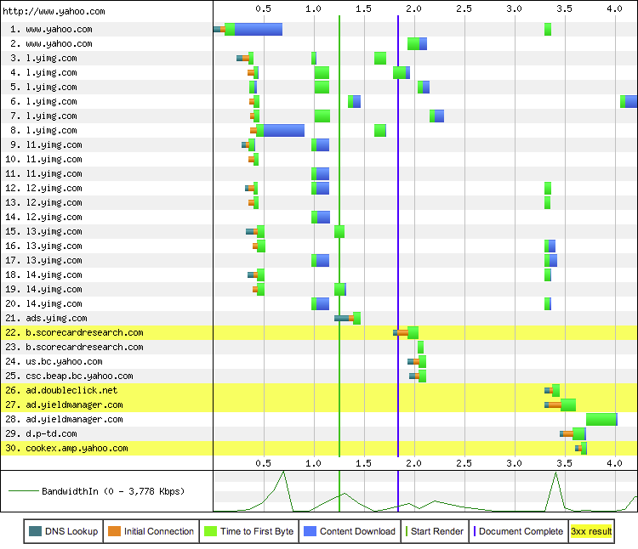
“Connection view” tells the story...
30 connections
DNS lookups
TCP handshakes
…
Blue: download time
We’re not BW limited, we’re literally idling, waiting on the network to deliver resources.
Mystery solved...
Speed, performance and human perception
@igrigorik

Slide 28
Upgrade to Linux 3.2+
Increases cwnd to 10!
Proportional rate reduction
Disable “slow-start after idle”
Ensure TCP window scaling is enabled
Re-use established TCP connections
HTTP keepalive (default on HTTP 1.1)
Position servers closer to the user
Lower RTTs! Use a CDN.
Compress transferred data
Optimizing for TCP (Chapter 2)

Slide 29
Now let’s make it secure...
TLS is an unoptimized frontier for most sites!

Slide 30
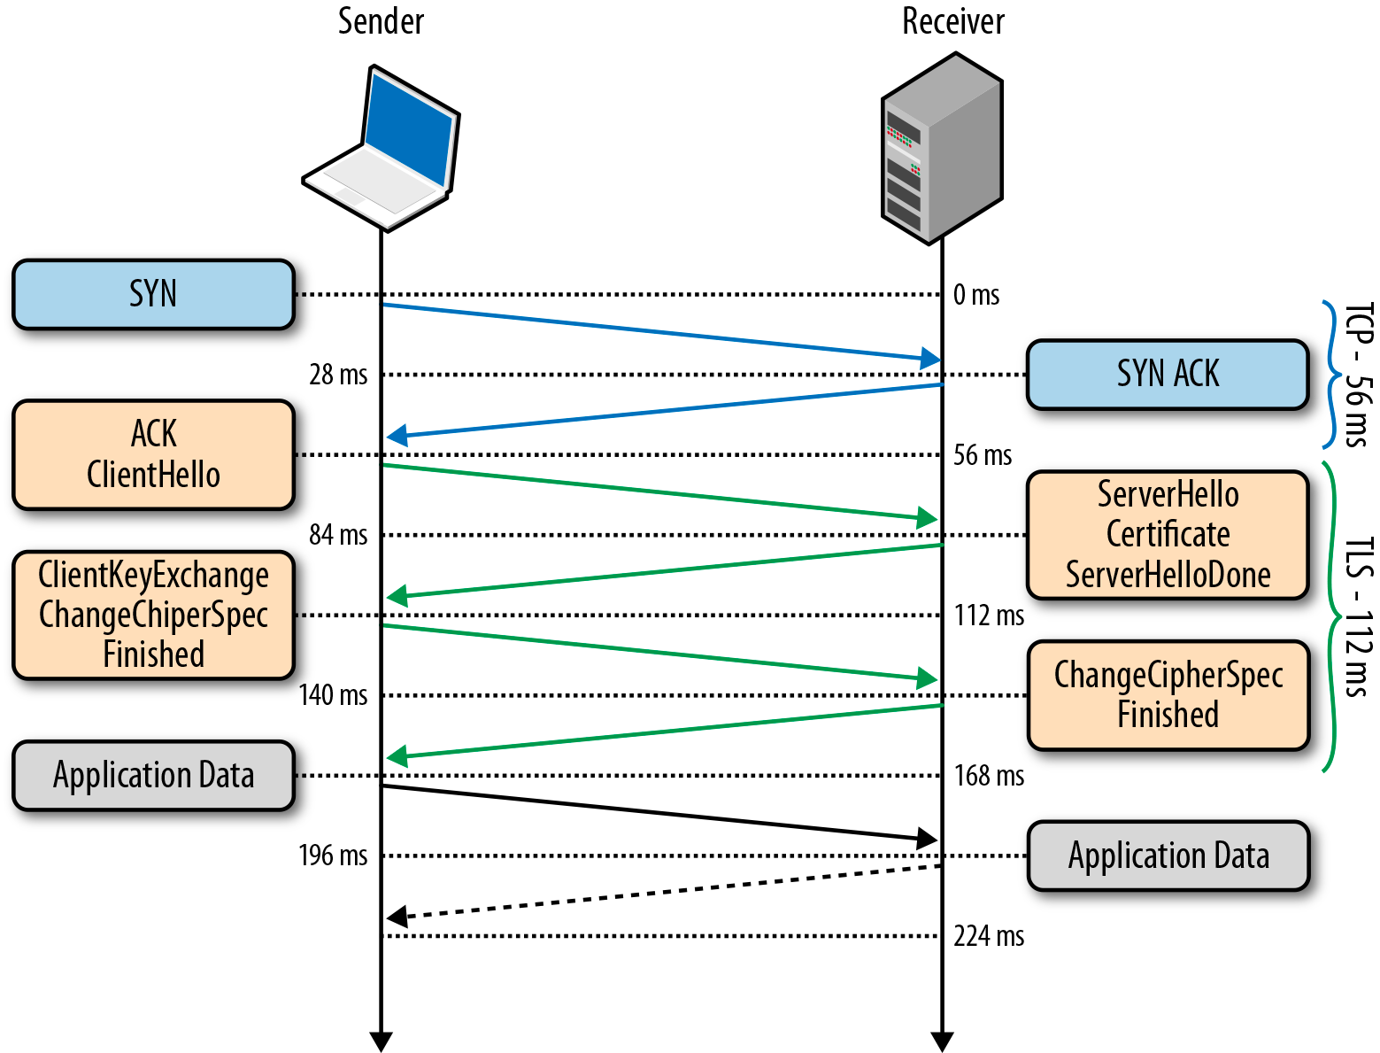
SYN, SYN-ACK, ACK, … ClientHello, ServerHello, ...
First, TCP handshake RTT!
Then…
ClientHello
ServerHello
ChangeCipher (client)
ChangeCipher (server)
3 RTTs to establish tunnel!
You might want to consider re-using TLS connections! Just saying...
Transport Layer Security (Chapter 4)
@igrigorik

Slide 31
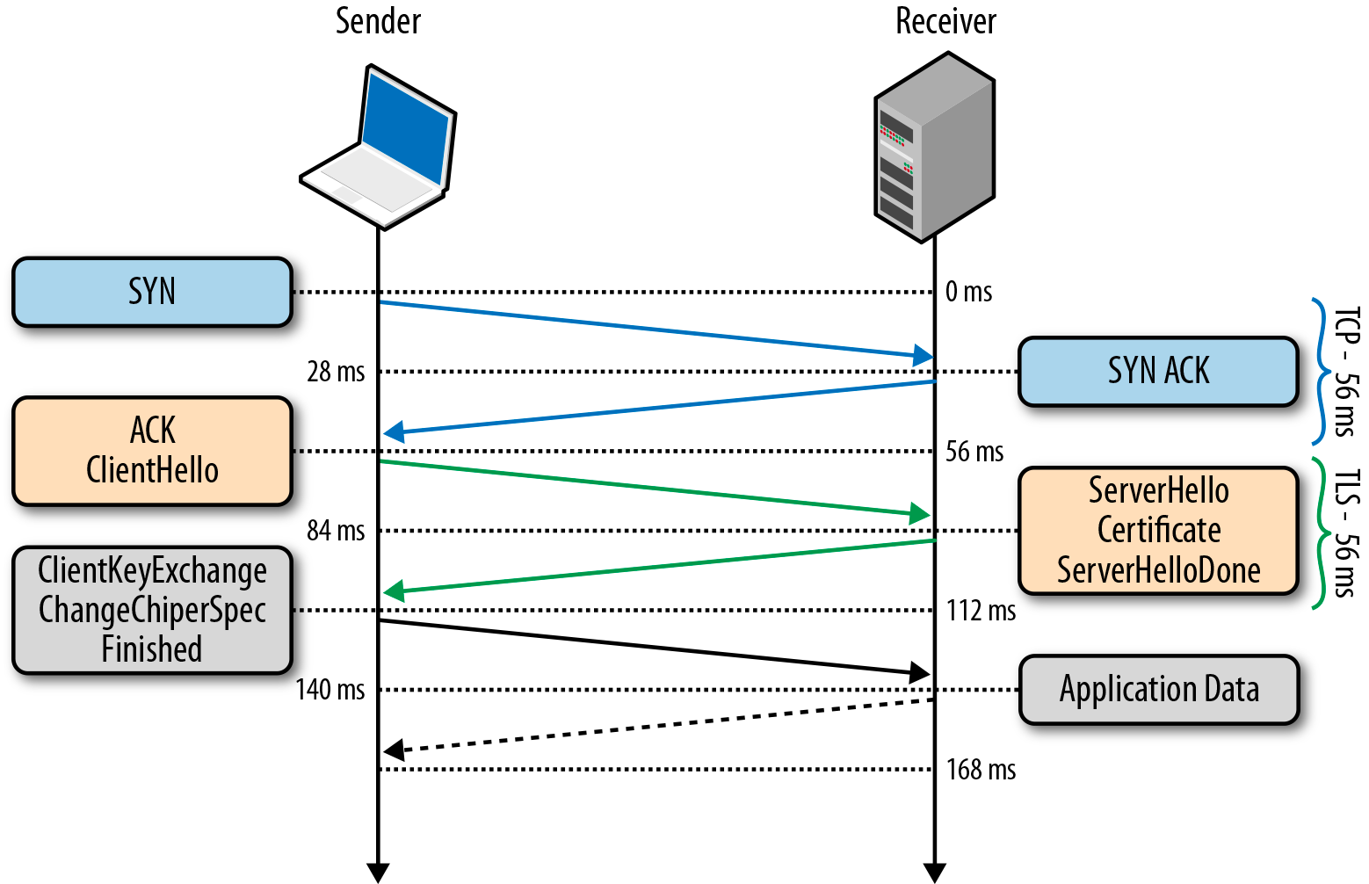
Session resumption removes one RTT!
Session Identifier (old)
Client sends session ID.
Session Ticket (new)
“Client cookie”
Verify that your server (at least) supports session ticket resumption.
Transport Layer Security (Chapter 4)
@igrigorik

Slide 32
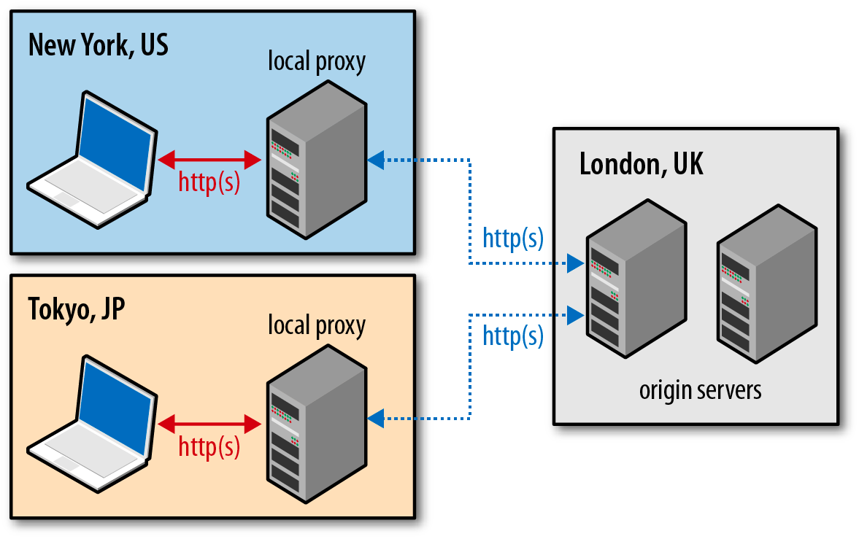
“Early termination” is a big win for TLS
Nearby edge server terminates TCP
TLS negotiation is with the edge
Applicable for static and dynamic content
Edge then routes to origin...
Via a “warm” connection
Early termination helps non-encrypted traffic also, but it is especially useful for accelerating TLS connections!
* Talk to your CDN provider, or, you can roll your own.. Spin up some “cloud servers” and you’re in business.
Transport Layer Security (Chapter 4)
@igrigorik

Slide 33
Start by optimizing TCP!
IW10, proportional rate reduction, ...
Upgrade to latest OpenSSL libraries
Big performance difference (try, $> openssl speed rsa)
Enable TLS resumption
Session Tickets, Session Identifiers
Optimize TLS record size
Reduce to single network segment
And a lot more...
Disable TLS compression (attack vector)
Configure SNI support (please!)
Configure OSCP stapling
Use HSTS to avoid costly HTTPS redirects
TLS Performance Checklist (Chapter 4)

Slide 34
Measuring network performance
Gathering data from real users, on real networks, with real devices...

Slide 35
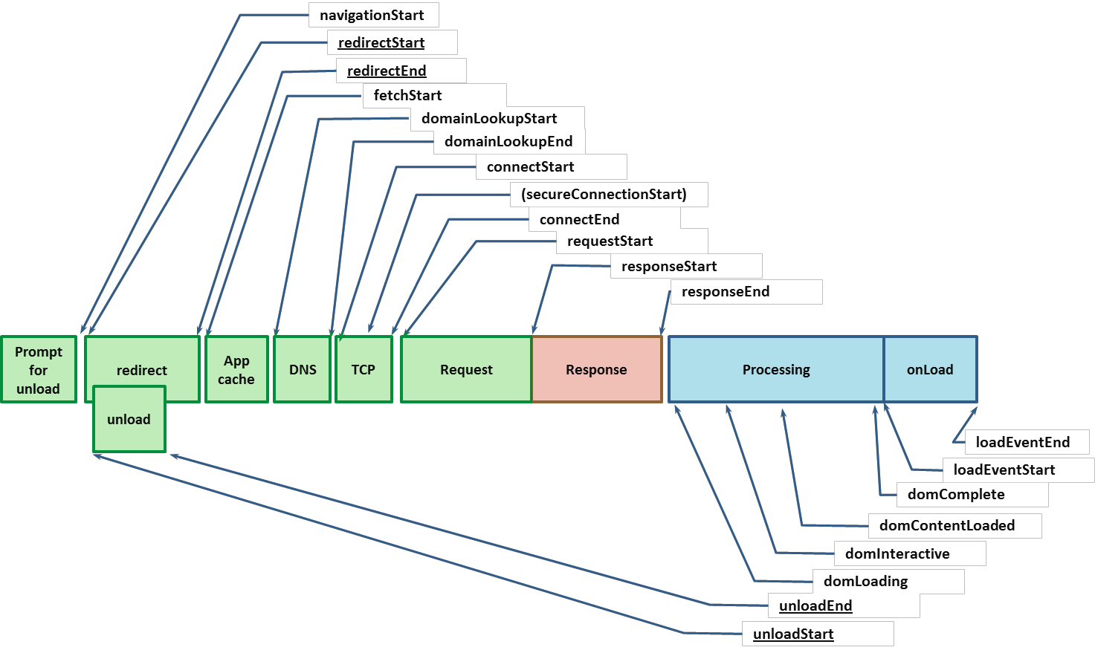
Navigation Timing (W3C)
Synthetic and Real-User Performance Measurement (Chapter 10)
@igrigorik

Slide 36
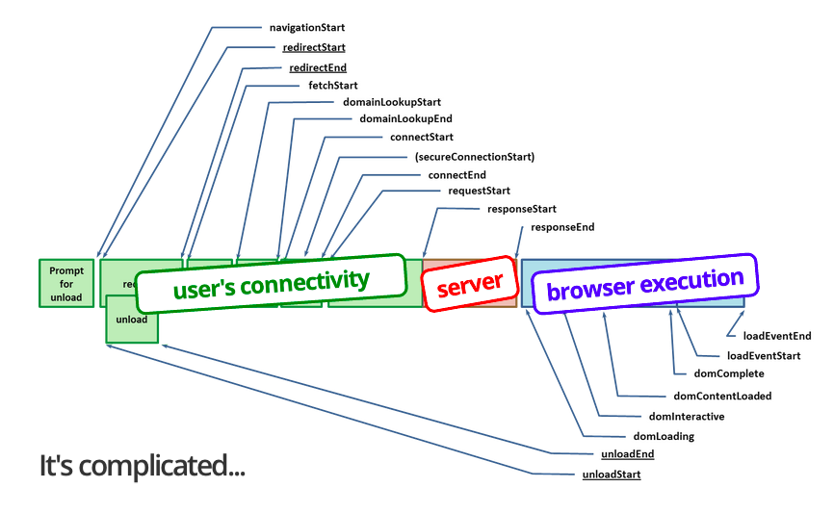
Navigation Timing (W3C)
Synthetic and Real-User Performance Measurement (Chapter 10)
@igrigorik

Slide 37
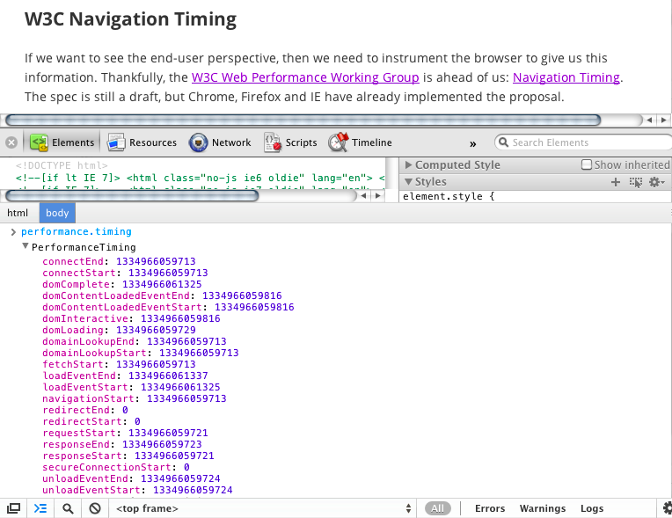
Available in...
IE 9+
Firefox 7+
Chrome 6+
Android 4.0+
@igrigorik

Slide 38
Real User Measurement (RUM) with Google Analytics
<script> _gaq.push(['_setAccount','UA-XXXX-X']); _gaq.push(['_setSiteSpeedSampleRate', 100]); // #protip _gaq.push(['_trackPageview']); </script>
Google Analytics > Content > Site Speed
Automagically collects this data for you - defaults to 1% sampling rate
Maximum sample is 10k visits/day
You can set custom sampling rate
You have all the power of Google Analytics! Segments, conversion metrics, ...
setSiteSpeedSampleRate docs
@igrigorik

Slide 39
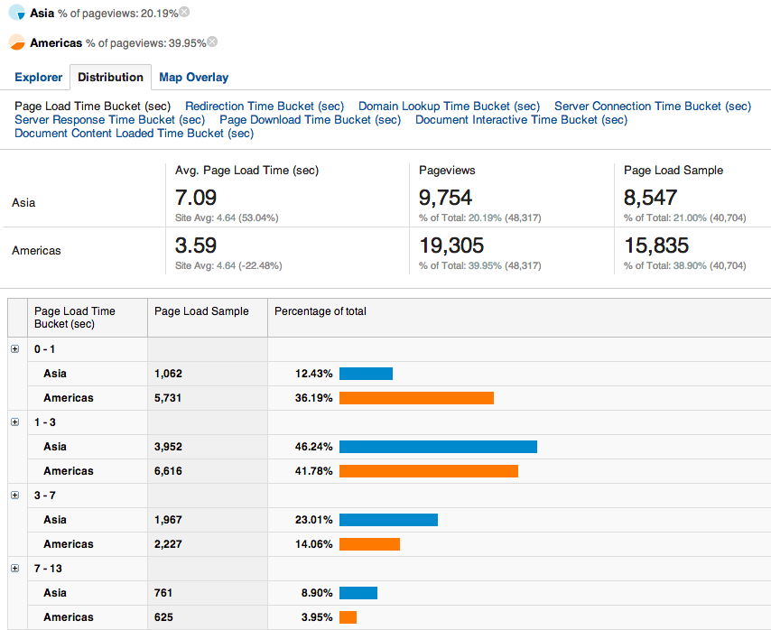
Full power of Google Analytics to segment, filter, compare, ...
@igrigorik

Slide 40
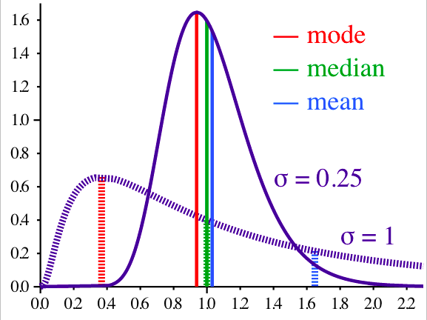
Averages are misleading...
Head into the Technical reports to see the histograms and distributions!
Synthetic and Real-User Performance Measurement (Chapter 10)
@igrigorik

Slide 41
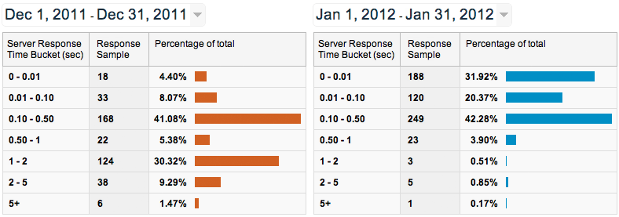
Case study: igvita.com server response times
Content > Site Speed > Page Timings > Performance
Bimodal response time distribution?
Theory: user cache vs. database cache vs. full recompute
Synthetic and Real-User Performance Measurement (Chapter 10)
@igrigorik

Slide 42
2G, 3G, 4G...
have fundamentally different architecture at the radio layer

Slide 43


Design criteria #1: "Stable" performance + scalability
Control over network performance and resource allocation
Ability to manage 10~100's of active devices within single cell
Coverage of much larger area

Slide 44

Design criteria #2: Battery life optimization
Radio is the second most expensive component (after screen)
Limited amount of available energy (as you are well aware)
Notes:
- move radio (second most expensive)

Slide 45
Design criteria #1: "Stable" performance + scalability
Design criteria #2: Maximize battery life
Radio Resource Controller (RRC)

Slide 46


Radio Resource Controller
Phone: Hi, I want to transmit data, please?
RRC: OK.
Transmit in [x-y] timeslots
Transmit with Z power
Transmit with Q modulation
... (some time later) ...
RRC: Go into low power state.
RRC
All communication and power management is centralized and managed by the RRC.
Mobile Networks (Chapter 7)
@igrigorik

Slide 47
Control and User-plane latencies
There is a one time cost for control-plane negotiation
User-plane latency is the one-way latency between packet availability in the device and packet at the base station
1-X RTT's of negotiations
2
RRC
I want to
send data!
3
Application data
1
 | LTE | HSPA+ | 3-3.5G
Idle to connected latency | < 100 ms | < 100 ms | < 2500 ms
User-plane latency | < 5 ms | < 10 ms | < 50 ms
Control-plane
User-plane
Same process happens for incoming data, just reverse steps 1 and 2
@igrigorik

Slide 48

Anticipate RRC latency...
 | HSPA (200 ms RTT) | HSPA+ / LTE (80 ms RTT)
Control plane | (200-2500 ms) | (50-100 ms)
DNS lookup | 200 ms | 80 ms
... | ... | ...
RRC
Plan for "first packet" delay
100's to 1000's of milliseconds of delay for first packet
Adjust UX accordingly!
Much of the "variability" is explained by RRC delays
you can't predict it, but assume you will incur it

Slide 49
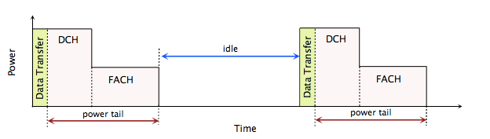
Watch those energy tails!
3G state machine
DCH = Active
FACH = Low power
IDLE = ...
Wasted energy
Every data transfer, both big and small, will:
cycle radio into high power
timer driven transition back to idle state
Mobile Networks (Chapter 7)
@igrigorik

Slide 50


It's all about the battery...
Minimize periodic data transfers
avoid polling, use adaptive strategy
coalesce requests, defer requests
leverage (smart) server push
Prefetch data
turn off the radio, keep it idle
Pandora beacons: 0.2% total bytes == 46% battery
A Call for More Energy-Efficient Apps

Slide 51
Hands on example....
5 Wh battery capacity
5 Wh * 3600 J/Wh = 18000 J battery capacity
10 Joules of consumed energy per "cycle"
idle → high-power → low-power → idle
60 minutes * 10 Joules = 600 Joules of consumed energy per hour
3% of battery capacity per hour! (600 J / 18000J)

Slide 52

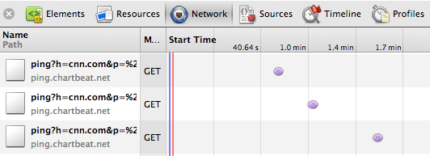
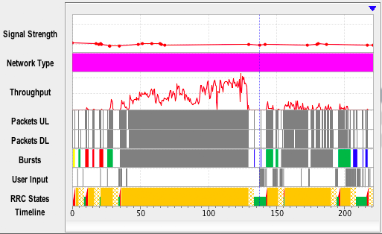
Measuring energy & radio...
Ping, ping, ping, ... where'd my battery go?
Watch out for...
"real-time" analytics
"real-time" comments
"real-time" <widget>...
Record live trace on the phone, or import a pcap!
Battery + radio models for 3G and 4G
Performance linter... caching, compression, etc.
...
Mobile Networks (Chapter 7)
@igrigorik

Slide 53
Physical connectivity (Radio)
Transport connectivity (TCP / UDP)
The radio can be off* while the transport is idle.
* The radio is never fully "off"... It wakes up periodically to listen to broadcasts and notifications!

Slide 54
window.setInterval(keepAlive(), 1000);
Carrier timeouts: 5-30 minutes.
eliminate unnecessary keep-alive beacons...
are you sure it's not your own servers forcing timeouts? :-)

Slide 55
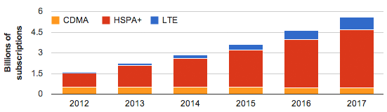
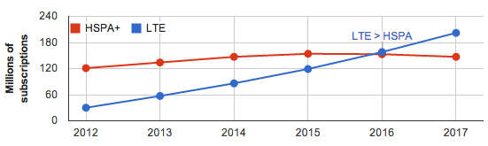

Not so good news everybody! ....
HSPA+ will be the dominant network type of the next decade!
Latest HSPA+ releases are comparable to LTE in performance
3G networks will be with us for at least another decade
LTE adoption in US and Canada is way ahead of the world-wide trends
Mobile Networks (Chapter 7)

Slide 56
Design for variable network performance & availability
It's a multi-generation future: 2G, 3G, 4G
users migrate between G's all the time... plan for it!
Bandwidth and latency is highly variable
burst your data, and return to idle...
Connectivity is intermittent, errors will happen!
have an offline mode - i.e. use a local cache
use a smart backoff algorithm, please!
var backoff = backoff.strategy({
randomisationFactor: 0,
initialDelay: 60,
maxDelay: 600
});
backoff.failAfter(10);

Slide 57
Hypertext Transfer Protocol
The good, the bad, … and the bright future ahead (aka, 2.0)

Slide 58
$> telnet igvita.com 80
Connected to 173.230.151.99
GET /archive
Hypertext delivery with HTTP 0.9! - eom.
(connection closed)
HTTP 0.9 is the ultimate MVP - one line, plain-text “protocol” to test drive the “www idea”.

Slide 59
$> telnet ietf.org 80
Connected to 74.125.xxx.xxx
GET /rfc/rfc1945.txt HTTP/1.0
User-Agent: CERN-LineMode/2.15 libwww/2.17b3
Accept: */*
HTTP/1.0 200 OK
Content-Type: text/plain
Content-Length: 137582
Last-Modified: Wed, 1 May 1996 12:45:26 GMT
Server: Apache 0.84
4 years of rapid iteration later… eom.
(connection closed)
HTTP 1.0 is an informational RFC - documents “common usage” of HTTP found in the wild.

Slide 60
$> telnet google.com 80
Connected to 74.125.xxx.xxx
GET /index.html HTTP/1.1
Host: website.org
User-Agent: Mozilla/5.0 (Macintosh; Intel Mac OS X 10_7_4)... (snip)
Accept: text/html,application/xhtml+xml,application/xml;q=0.9,*/*;q=0.8
Accept-Encoding: gzip,deflate,sdch
Accept-Language: en-US,en;q=0.8
Cookie: __qca=P0-800083390... (snip)
HTTP/1.1 200 OK
Connection: keep-alive
Transfer-Encoding: chunked
Server: nginx/1.0.11
Content-Type: text/html; charset=utf-8
Date: Wed, 25 Jul 2012 20:23:35 GMT
Expires: Wed, 25 Jul 2012 20:23:35 GMT
Cache-Control: max-age=0, no-cache
100
<!doctype html>
(snip)
HTTP 1.1 ships as RFC standard in 1999 - hyper{t̶e̶x̶t̶}media all the things!

Slide 61


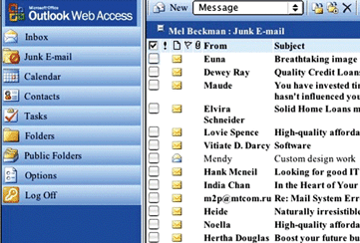
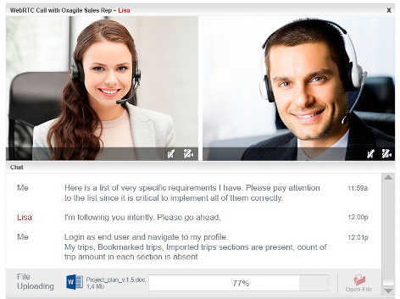
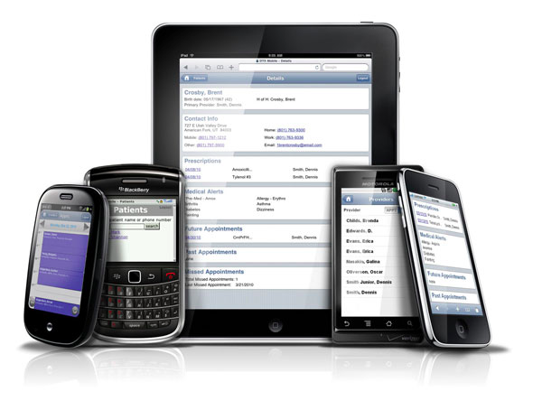
15 years later!
HTTPbis is getting dangerously close to closing all the outstanding 1.1 bugs. :)
In the meantime a few things have happened since...
WebGL
WebRTC
Web Audio
WebSockets
…
Mobile web
(today)
Geocities ftw! (circa 1997-2000)
Then AJAX happened.
(circa 2002-2005)
Speed, performance and human perception
@igrigorik

Slide 62
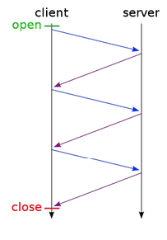
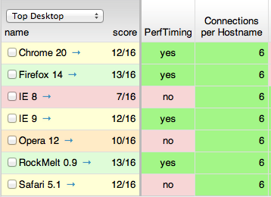
For all its awesome, HTTP 1.X has a lot of perf problems...
Limited parallelism (~6)
Client-side request queuing
Browser queueing heuristics
High protocol overhead
~800 bytes + cookies
Competing TCP flows
Spurious retransmissions
Extra memory / FD resources
Handshake overhead
Slow-start overhead
…
@igrigorik

Slide 63
Dozens of competing TCP flows...
Most stuck in Slow Start
Poor congestion control
Poor link utilization
Setup latency + overhead
Extra sockets
Extra memory
…
In short, there is no upside to this. But that’s what we have to work with...
Speed, performance and human perception
@igrigorik

Slide 64
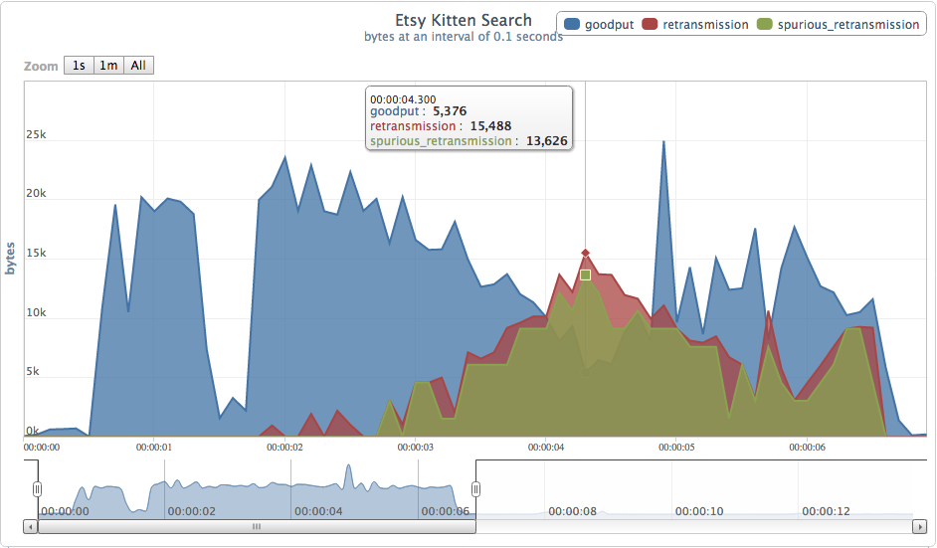
E.g. Etsy over-sharding...
img[0-3].etsystatic.com
~30 connections
Too much of a “good thing” can cause harm. In this case, parallel flows are competing and cause a significant amount of spurious retransmissions (duplicate bytes on the client).
Speed, performance and human perception
@igrigorik
Network Congestion and Web Browsing

Slide 65
Where there’s a will, there’s a way...
we’re an inventive bunch, so we came up with some “optimizations” (read, “hacks”)

Slide 66

Domain sharding
TCP Slow Start? Browser limits, Nah... 15+ parallel requests -- Yeehaw!!!
Causes congestion and unnecessary latency and retransmissions
Concatenating files (JavaScript, CSS)
Reduces number of downloads and latency overhead
Less modular code and expensive cache invalidations (e.g. app.js)
Slower execution (must wait for entire file to arrive)
Spriting images
Reduces number of downloads and latency overhead
Painful and annoying preprocessing and expensive cache invalidations
Have to decode entire sprite bitmap - CPU time and memory
Resource inlining
Eliminates the request for small resources
Resource can’t be cached, inflates parent document
30% overhead on base64 encoding

Slide 67
… why not fix HTTP instead?

Slide 68
Improve end-user perceived latency
Address the "head of line blocking"
Not require multiple connections
Retain the semantics of HTTP/1.1
"HTTP 2.0 is a protocol designed for low-latency transport of content over the World Wide Web"
HTTP 2.0 work kicked off in Jan 2012.

Slide 69
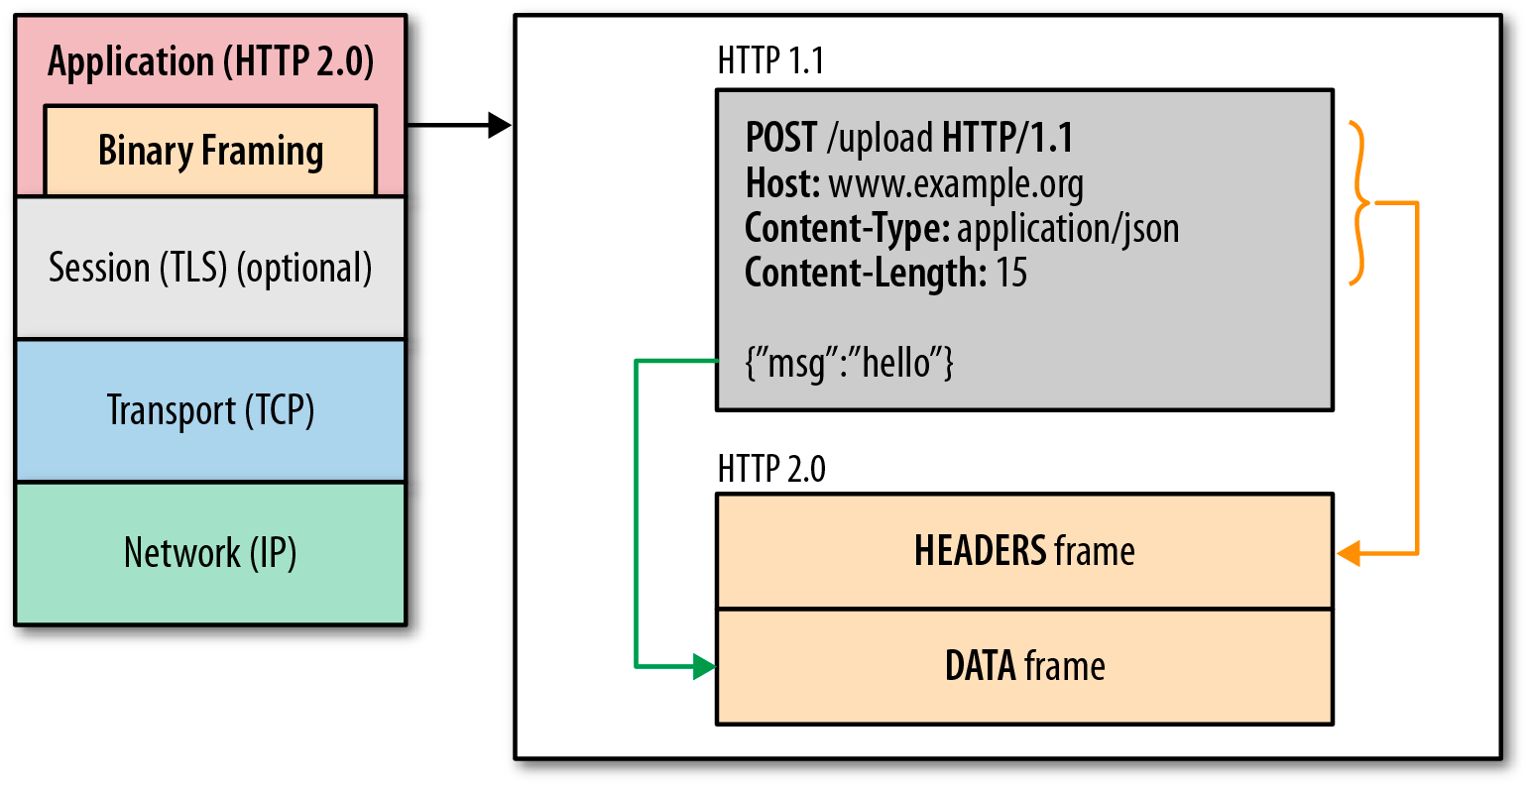
HTTP 2.0 in one slide…
One TCP connection
Request = Stream
Streams are multiplexed
Streams are prioritized
Binary framing layer
Prioritization
Flow control
Server push
Header compression
@igrigorik

Slide 70
“... we’re not replacing all of HTTP — the methods, status codes, and most of the headers you use today will be the same. Instead, we’re redefining how it gets used “on the wire” so it’s more efficient, and so that it is more gentle to the Internet itself ....”
- Mark Nottingham (HTTPbis chair)

Slide 71
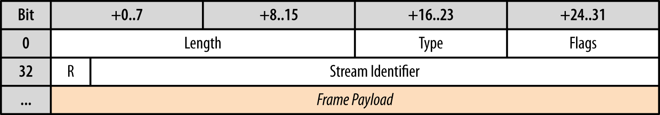
Binary framing crash course in one slide...
Length-prefixed frames
All frames have same 8-byte header
Type indicates … type of frame:
DATA, HEADERS, PRIORITY, PUSH_PROMISE, …
Each frame may have custom flags
e.g. END_STREAM
Each frame carries a 31-bit stream identifier
After that, it’s frame specific payload
frame = buffer.read(8)
if frame_i_care_about
do_something_smart
else
buffer.skip(frame.length)
end
@igrigorik

Slide 72
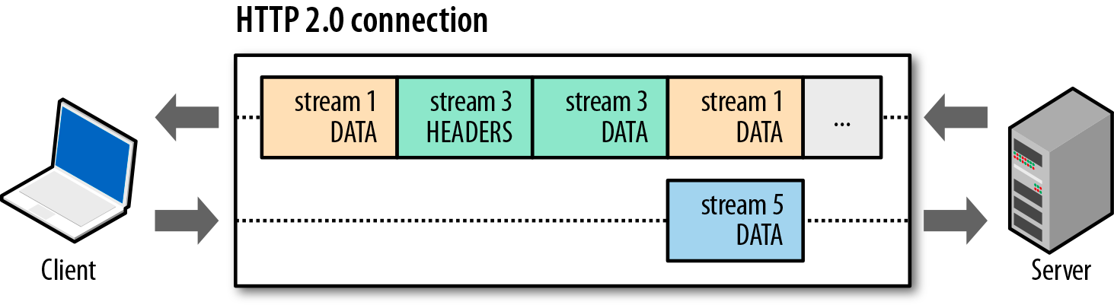
Basic data flow in HTTP 2.0...
Streams are multiplexed by splitting communication into frames
e.g. HEADERS, DATA, etc.
Frames are interleaved
Frames can be prioritized
Frames can be flow controlled
E.g. Please send critical.css with priority 1, please! kittens.jpg with priority 10.
@igrigorik

Slide 73
Connection + stream flow-control!
Stream flow-control enables fine-grained resource control between streams. E.g…
T(0): I am willing to receive 64 KB of kittens.jpg.
T(0): I am willing to receive 500KB of critical.js
…
T(n): Ok, now send the remainder of kittens.jpg.
Client controls how and when the stream and connection window is incremented!
@igrigorik

Slide 74
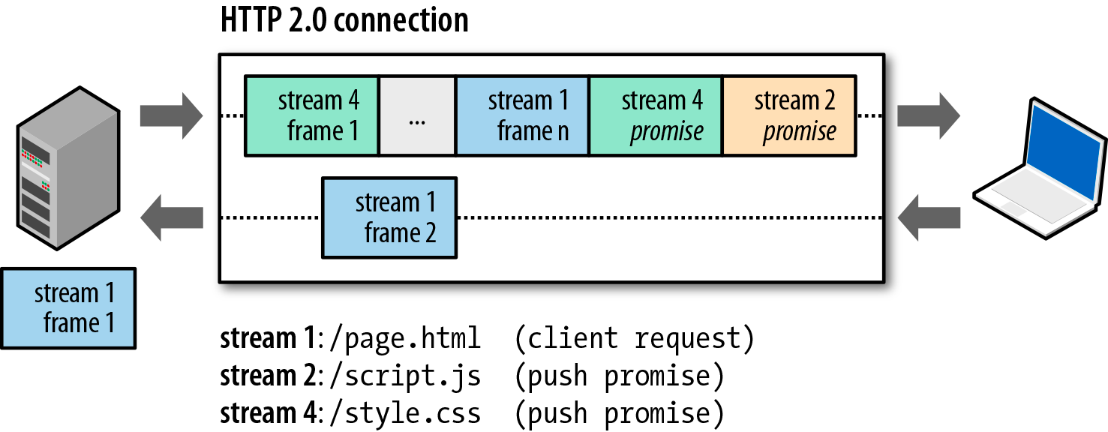
Server push… is replacing inlining.
Inlining is server push. Except, HTTP 2.0 server push is cacheable!
One request, multiple responses.
Push redirects, cache invalidations, … lots of new and exciting possibilities!
@igrigorik

Slide 75
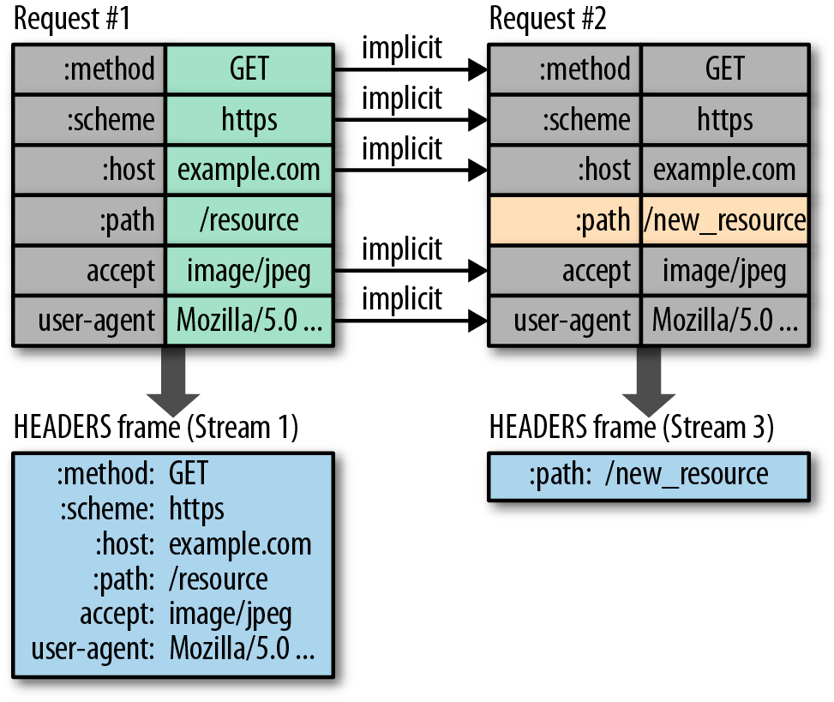

HTTP 2.0 provides header compression!
Both sides maintain “header tables”
New requests “toggle” or “insert” new values into the table
New header set is a “diff” of the previous set of headers
Repeat request (polling) with exact same headers incurs no overhead
Byte cost of new stream: 8 bytes! *
* as low as 8 bytes for an identical request.
@igrigorik

Slide 76
tl;dr: framing, mux, prioritization, flow control
same HTTP protocol semantics, complete performance reboot!

Slide 77
Benefits
Opportunities
Unshard, un-concat, un-sprite, …
Modular code, modular assets
Improved cache performance
Improved page load times
Layer other browser transports
XHR / SSE: work out of the gate
(TODO) WebSockets over HTTP 2.0: free mux, flow control, prioritization
We need smarter servers!
Support for prioritization, flow control, and resource push!
One RPC stack to rule them all
Standardized, high-performance RPC protocol stack (internal, external)
min(request overhead) = 8 bytes
max(parallelism) = 100~1000 streams
max(client queueing latency) = 0 ms
Stream multiplexing
Stream prioritization
Stream flow control
Server push
Plus all the usual HTTP goodies!
Browser caching, authentication, content negotiation, content-encoding, transfer encoding, encryption, …
Available in your browser circa ~2014! *
* or today, via SPDY.
@igrigorik

Slide 78
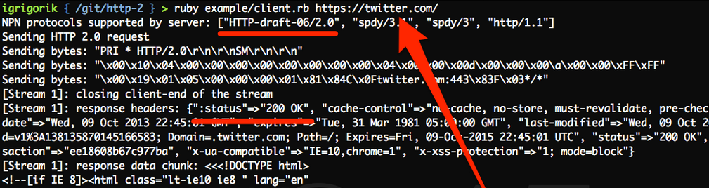
HTTP 2.0 draft 6 implementations in Firefox, Chrome, IE11
has SPDY support (stepping stone). Plus client/server
implementations in C, JavaScript (node.js), Ruby, Perl, etc.
HTTP 2.0 is coming to a client / server near you in 2014.
github.com/igrigorik/http-2

Slide 79
Start by optimizing TCP!
IW10, proportional rate reduction, …
Ensure you have keep-alive enabled!
Use HSTS to avoid costly HTTPS redirects
Optimize your TLS deployments
Record and cert sizes, session resumption, ...
Compress and eliminate
Enable gzip (please!) and fetch what you need
Cache
Too many sites are missing cache headers to this day
Expiry / max-age and revalidation (Etag, Last-Modified)
Investigate SPDY / HTTP 2.0
Optimizing Application Delivery (Chapter 13)

Slide 80
Are we fast yet?
Slides @ bit.ly/hpbn-talk
Twitter igrigorik
Email igrigorik@google.com
P.S. Check out the book for (much) more!

Slide 81

Not fast enough? Ok, let’s talk

Slide 82
WiFi performance
requires its own (unique) set of optimizations...

Slide 83
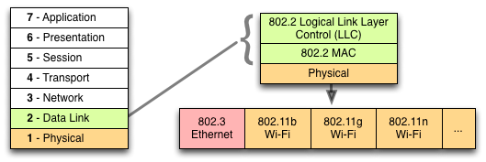
Wireless LAN, aka Wi-Fi...
Wireless extension to existing LAN infrastructure
Same protocol stack, new physical medium
First commercial success ~1999 with 802.11b (11 Mbps)
Target: desktop, laptop
WiFi (Chapter 6)
@igrigorik

Slide 84
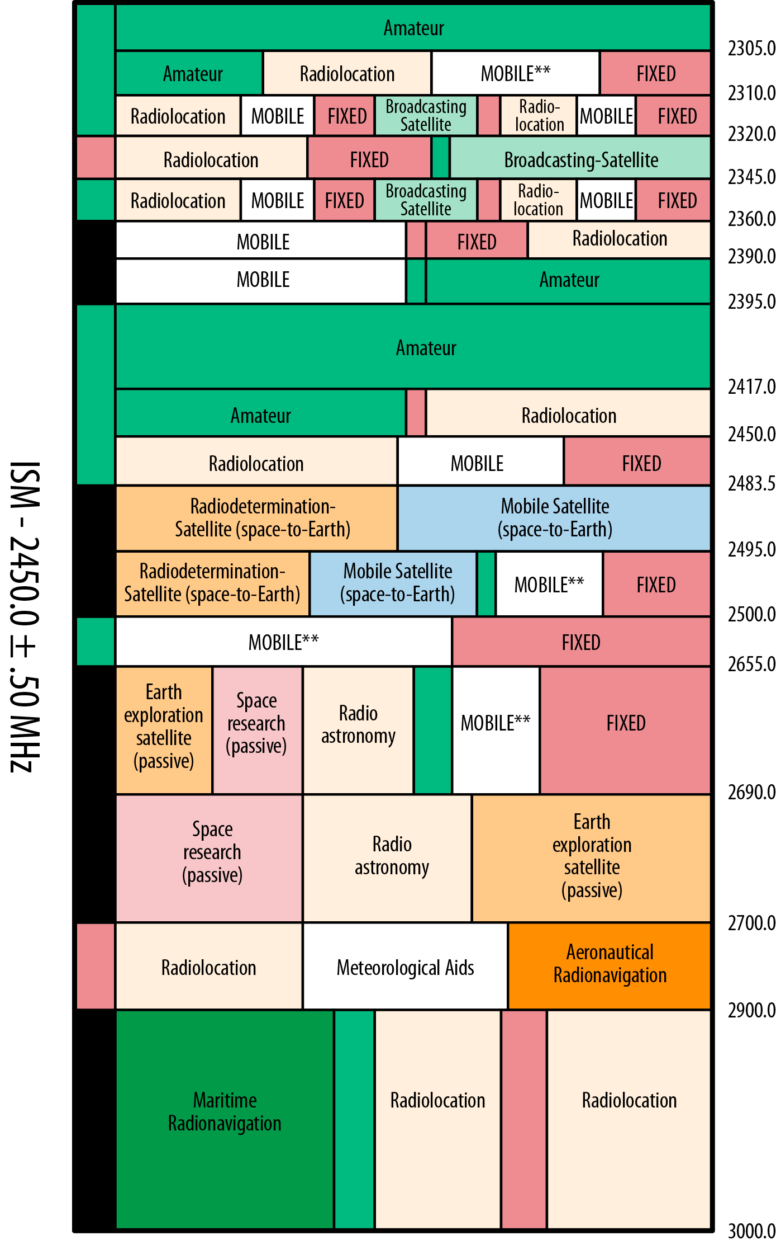

Limited amount of shared spectrum
Multiple parties who want to transmit and receive
How do we schedule communication?
WiFi (Chapter 6)
@igrigorik

Slide 85
Carrier Sense Multiple Access + Collision Detection
Is anyone talking?
No: begin transmission
Yes: wait until they finish
Collision: stop, sleep for rand() with backoff, retry
There is not much more to it...
WiFi (Chapter 6)
@igrigorik

Slide 86
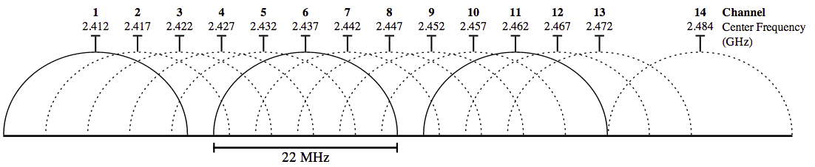
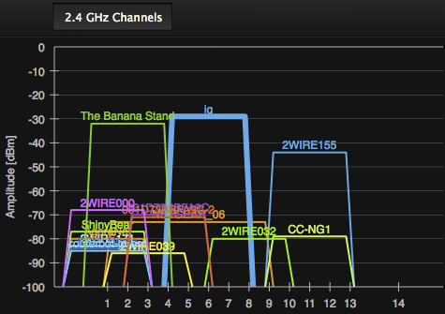
Wi-Fi channels 101
Non-overlapping channels: 1, 6, 11
Wi-Fi is a victim of its own success
Any user, on any network (in the same channel) can and will affect your latency and throughput!
10-20+ overlapping networks in same channel
shared access medium
WiFi (Chapter 6)
@igrigorik

Slide 87
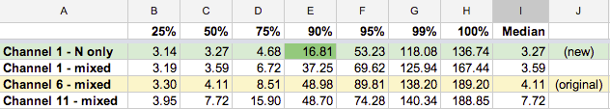
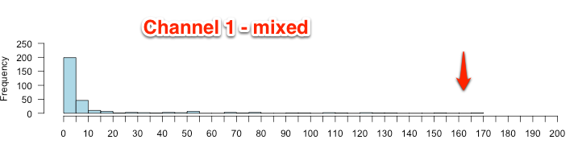
Real-world Wi-Fi performance: 2.4 Ghz vs 5 Ghz (YMMV)
Real-world 1st hop latency
Upgraded router, removed ~50 ms of latency on
first hop!
 | Median (ms) | 95% (ms) | 99% (ms)
2.4 Ghz | 6.22 | 34.87 | 58.91
5 Ghz | 0.90 | 1.58 | 7.89
Sample data from my own home Wi-Fi network...

Slide 88

Adapt to variable bandwidth
Adaptive bitrate streaming
5-10 second chunks of video content
Adapt, do not predict!
Adapt to variable latency and jitter
High variability for first hop for every packet
Jitter in packet arrival times
Variability != packet loss
Link layer retransmissions and error correction...

